Slide 1

Unit 2
Histogram Matching (Specification)

Slide 4
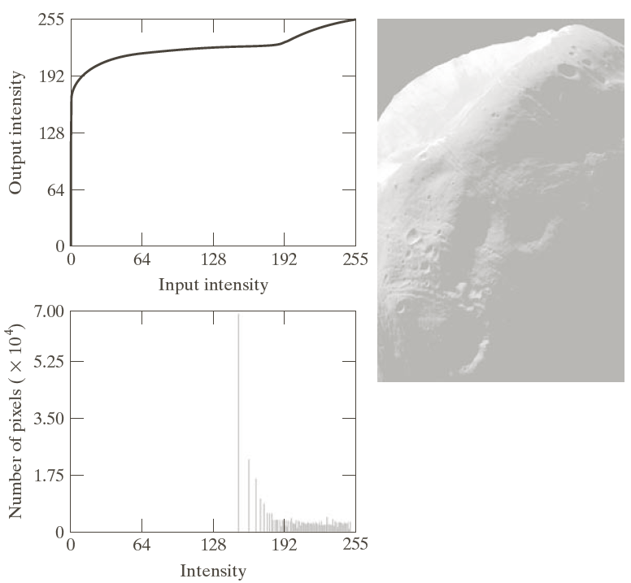

Slide 5
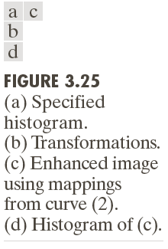

Slide 6
We have an original histogram and a target histogram.
Image has to be processed in such a way that the histogram of the processed image must be the same as that of the target histogram
Steps:
Equalize both the histograms
Map the target histogram and the original histogram
Input
Target
Intensity values | No. of pixels
0 | 8
1 | 10
2 | 10
3 | 2
4 | 12
5 | 16
6 | 4
7 | 2
Intensity values | No. of pixels
0 | 0
1 | 0
2 | 0
3 | 0
4 | 20
5 | 20
6 | 16
7 | 8

Slide 7
Equalize the original histogram
 |  | P(r) | Sk | S’
0 | 8 | 0.13 | 0.13 | 0.91 | 1
1 | 10 | 0.16 | 0.29 | 2.03 | 2
2 | 10 | 0.16 | 0.45 | 3.15 | 3
3 | 2 | 0.03 | 0.48 | 3.16 | 3
4 | 12 | 0.18 | 0.66 | 4.62 | 5
5 | 16 | 0.25 | 0.91 | 6.37 | 6
6 | 4 | 0.06 | 0.97 | 6.79 | 7
7 | 2 | 0.03 | 1 | 7 | 7

Slide 8
Equivalize the Target histogram
 |  | P(r) | Sk | S’
0 | 0 | 0 | 0 | 0 | 0
1 | 0 | 0 | 0 | 0 | 0
2 | 0 | 0 | 0 | 0 | 0
3 | 0 | 0 | 0 | 0 | 0
4 | 20 | 0.31 | 0.31 | 2.17 | 2
5 | 20 | 0.31 | 0.62 | 4.34 | 4
6 | 16 | 0.25 | 0.87 | 6.09 | 6
7 | 8 | 0.125 | 0.995 | 7 | 7

Slide 9
Mapping Process
r | No. of pixels in original | No. of pixels in target | mapped
0 | 1 | 0 | 4
1 | 2 | 0 | 4
2 | 3 | 0 | 5
3 | 3 | 0 | 5
4 | 5 | 2 | 6
5 | 6 | 4 | 6
6 | 7 | 6 | 7
7 | 7 | 7 | 7
0 of the original image got changed to 1
What value of the target image went to 1 (or the closest )?
0->1->4
1 of the original image got changed to 2.
what value of the target image got changed to 2?
1->2->4
2->3->5

Slide 10
Example 2: Match the given input histogram with the given target histogram
Input
Target
Intensity values | No. of pixels
0 | 790
1 | 1023
2 | 850
3 | 656
4 | 329
5 | 245
6 | 122
7 | 81
Intensity values | No. of pixels
0 | 0
1 | 0
2 | 0
3 | 614
4 | 819
5 | 1230
6 | 819
7 | 614

Slide 11
Equalize the original histogram
 |  | P(r) | Sk | S’
0 | 790 | 0.19 | 0.19 | 1.33 | 1
1 | 1023 | 0.25 | 0.44 | 3.08 | 3
2 | 850 | 0.21 | 0.65 | 4.55 | 4
3 | 656 | 0.16 | 0.81 | 5.67 | 6
4 | 329 | 0.08 | 0.89 | 6.23 | 6
5 | 245 | 0.06 | 0.95 | 6.65 | 7
6 | 122 | 0.03 | 0.98 | 6.86 | 7
7 | 81 | 0.02 | 1 | 7 | 7

Slide 12
Equivalize the Target histogram
 |  | P(r) | Sk | S’
0 | 0 | 0 | 0 | 0 | 0
1 | 0 | 0 | 0 | 0 | 0
2 | 0 | 0 | 0 | 0 | 0
3 | 614 | 0.149 | 0.149 | 1.05 | 1
4 | 819 | 0.20 | 0.35 | 2.5 | 2
5 | 1230 | 0.30 | 0.65 | 4.55 | 4
6 | 819 | 0.20 | 0.85 | 5.97 | 6
7 | 614 | 0.15 | 1 | 7 | 7

Slide 13
r | No. of pixels in original | No. of pixels in target | mapped
0 | 1 | 0 | 3
1 | 3 | 0 | 5
2 | 4 | 0 | 5
3 | 6 | 1 | 6
4 | 6 | 2 | 6
5 | 7 | 4 | 7
6 | 7 | 6 | 7
7 | 7 | 7 | 7

Slide 14
Local Histogram Equalization
Methods discussed so far include Global
Applied on the entire image
Suitable for overall enhancement
Fails to enhance minute details over small areas of the image
Local processing must be done for this
Transformation function is based on the intensity of the neighborhood pixels
Equalization or matching done in the neighbourhood
To reduce computation use nonoverlapping regions
Results may not be accurate

